Slide 1
Scaling Apps with the new Autoscaler CLI for PCF v2.1
Chris Busch, Platform Architect
April, 2018

Slide 2
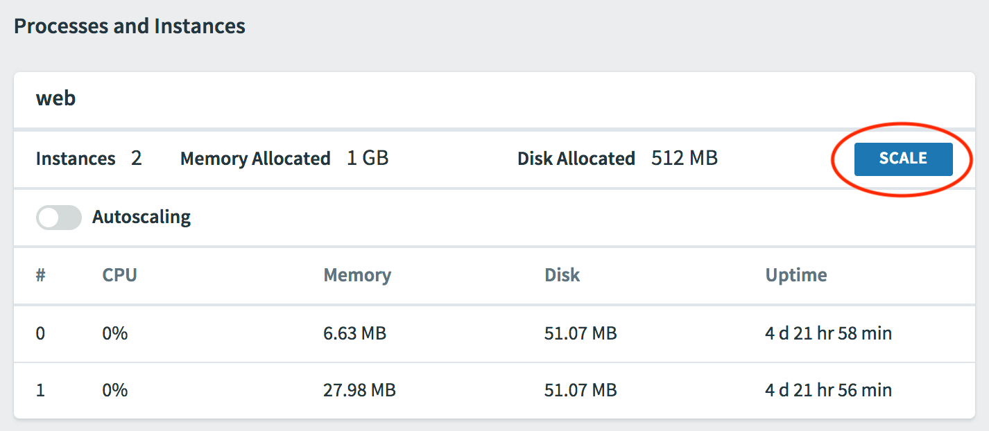
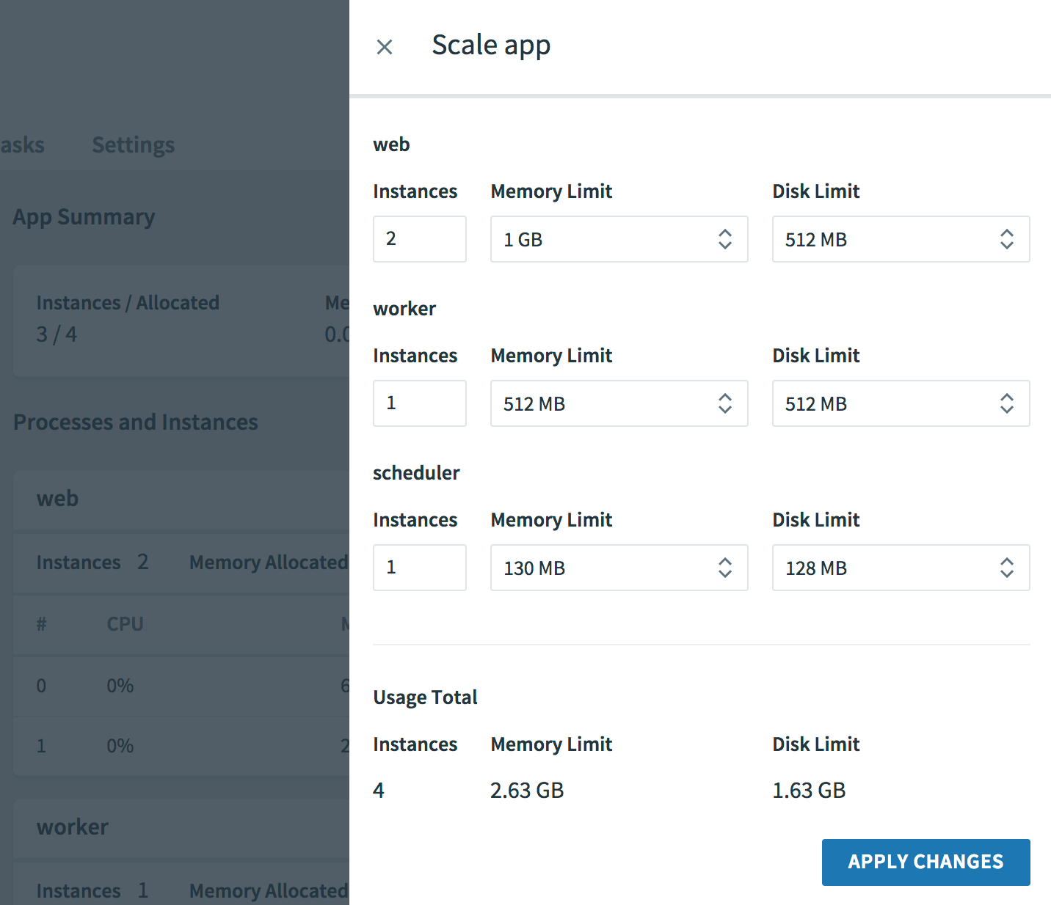
Apps Manager - View and Scale Apps Manually
Adjust either horizontal scaling with the Instance counts or vertical scaling with Memory and Disk limit changes, which alters the container size with a complete app restart.
http://docs.pivotal.io/pivotalcf/2-1/console/manage-apps.html#scale

Slide 3
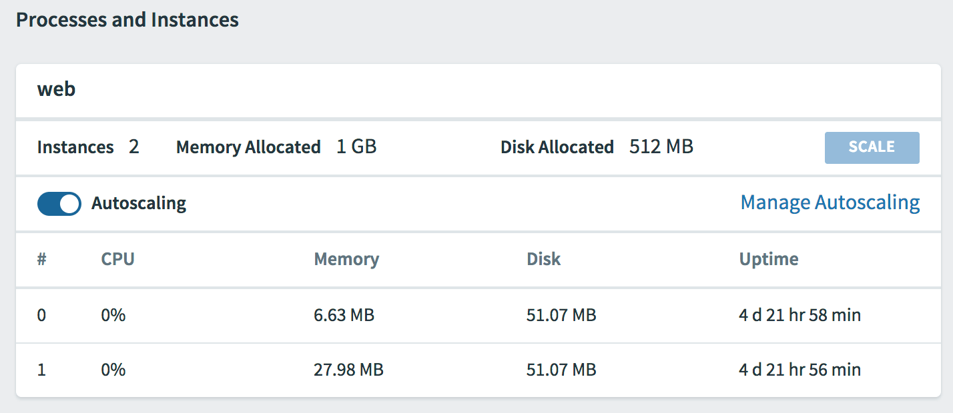
Configure App Autoscaler
Turn on Autoscaling with slider, which creates an autoscaler service instance and binds it to your processes and instances.
Click Manage Autoscaling link to open App Autoscaler
http://docs.pivotal.io/pivotalcf/2-1/appsman-services/autoscaler/using-autoscaler.html#setup

Slide 4
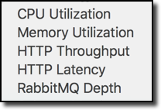
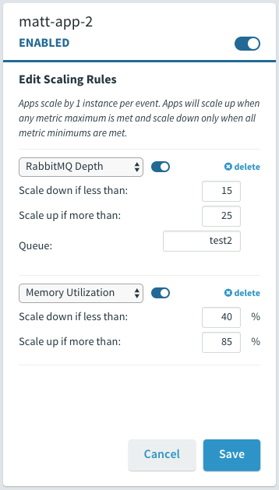
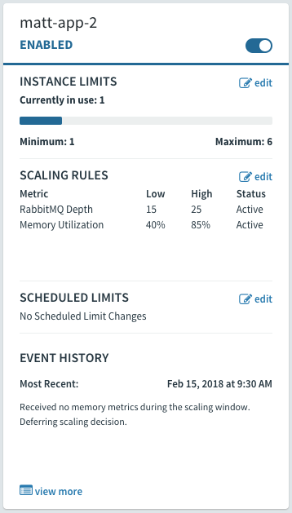
Manage Scaling with New App Autoscaler Metrics
App Autoscaler
Two New Autoscaling Rule Types [demo]
Container Memory Utilization: The average RAM percentage used for all instances of the app.
RabbitMQ Depth: The length of a specified RabbitMQ queue.
http://docs.pivotal.io/pivotalcf/2-1/appsman-services/autoscaler/using-autoscaler.html#config

Slide 5

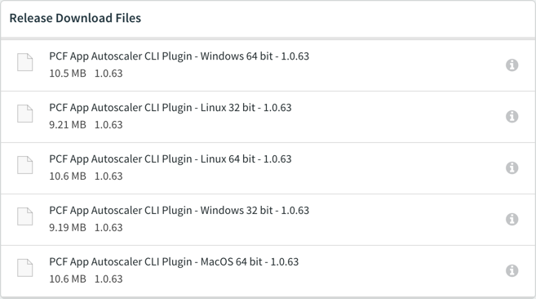
App Autoscaler CLI Plugin
Plugin to existing CF CLI $ cf install-plugin \ autoscaler-for-pcf-cliplugin-macosx64-binary-1.0.42
Supports multiple operating systems
Download from the Pivotal Network for your operating system.
https://network.pivotal.io/products/pcf-app-autoscaler

Slide 6
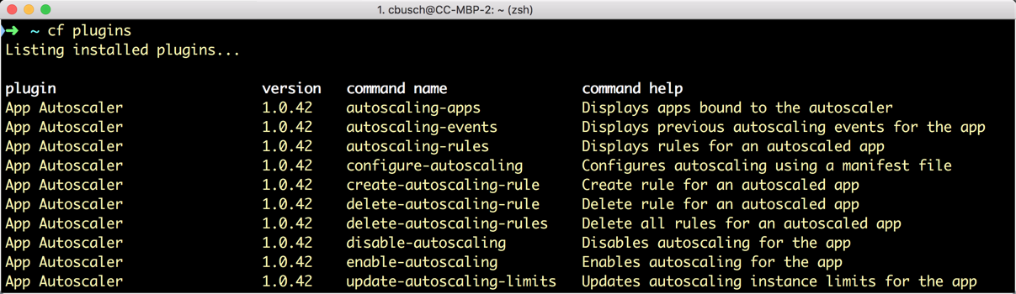
App Autoscaler CLI
Create and manage App Autoscaler rules from a shell or programmatically for a CI/CD pipeline
Alternative to the PCF App Autoscaler UI in Apps Manager
https://docs.pivotal.io/pivotalcf/2-1/appsman-services/autoscaler/using-autoscaler-cli.html

Slide 7
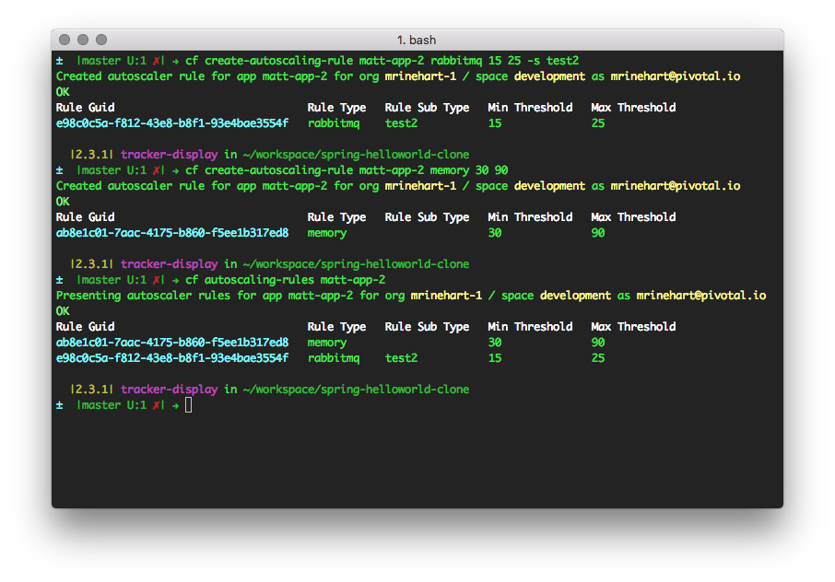
App Autoscaler: New CLI Plugin
Mac, Windows, and Linux versions of the CLI plugin will be available for download on Pivnet for PCF 1.10 - 2.1 in March 2018.
Click to view a demo

Slide 8
Autoscaling Lab
PCF 2.1

Slide 9

Transforming How The World Builds Software
© Copyright 2017 Pivotal Software, Inc. All rights Reserved.

